Slide 1

The M2O and VLBI observations of maser bursts
Ross Burns
Mizusawa UM Dec 2019

Slide 2
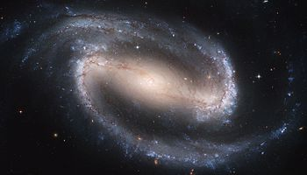
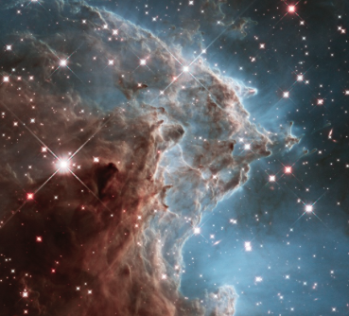

HMSF
Masers
M2O
G358
Future work
Topic:
Massive star formation
?
?
Formation
?

Slide 3
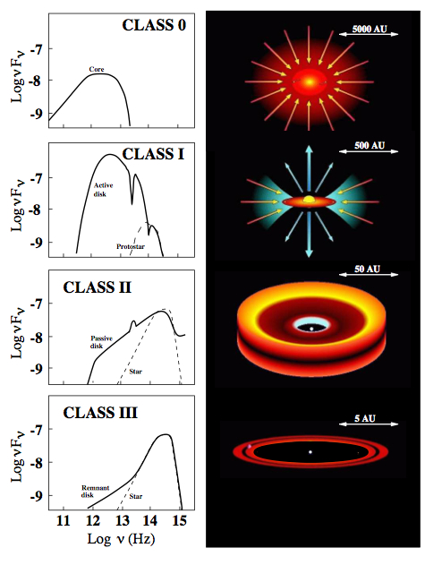
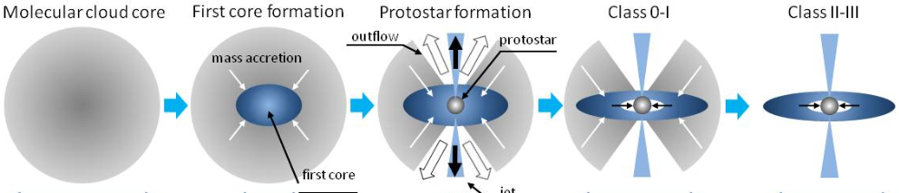
HMSF
Masers
M2O
G358
Future work
Problem:
Radiation pressure
Low mass stars:
UV
High mass stars:
Radiation
pressure

Slide 4

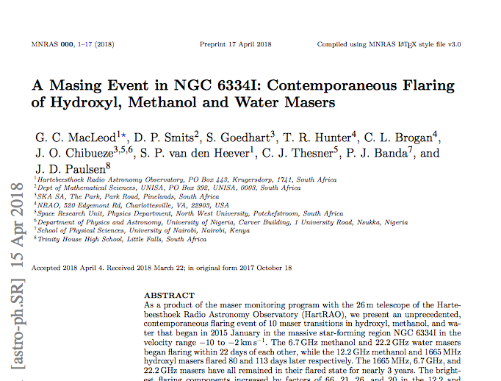
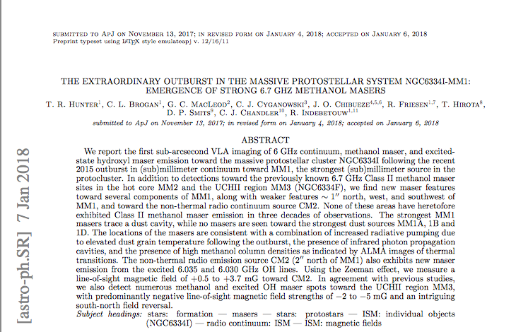
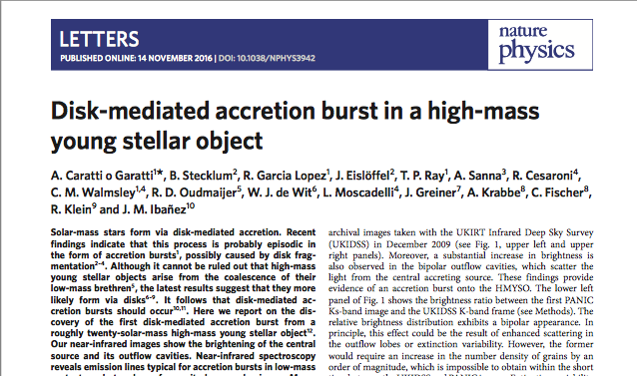
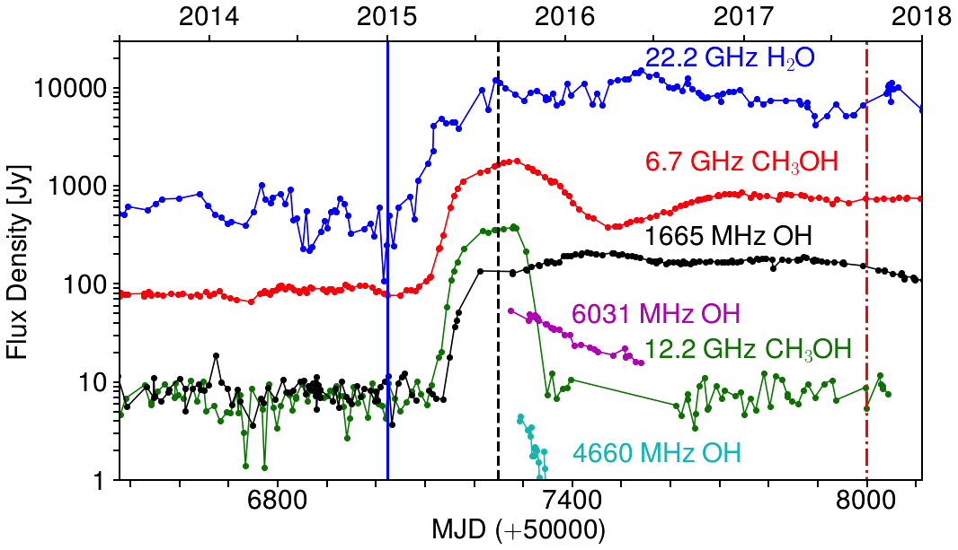
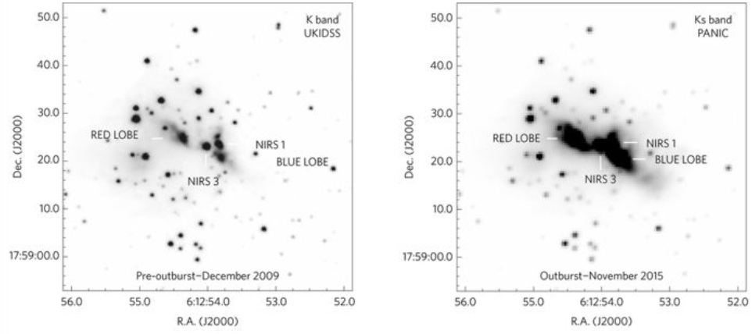
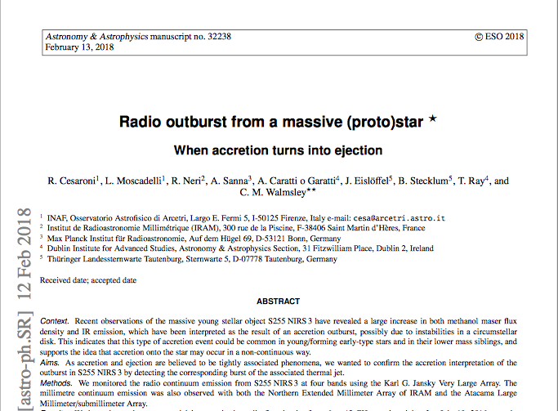
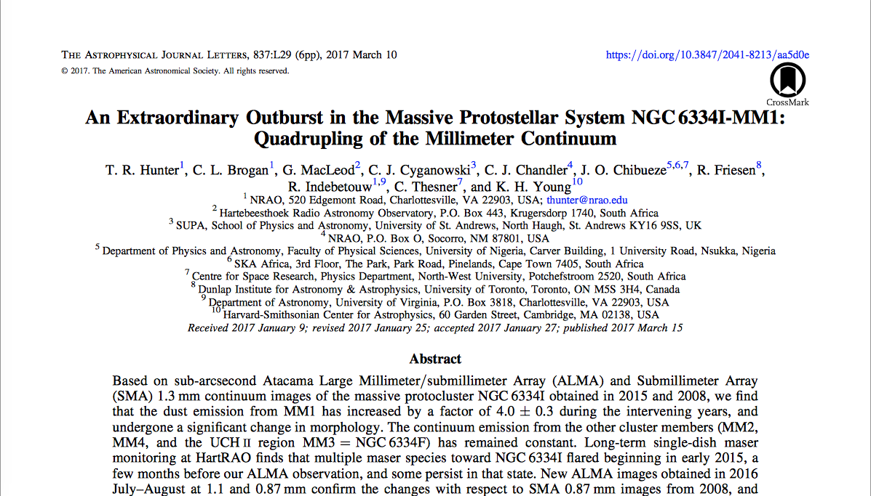
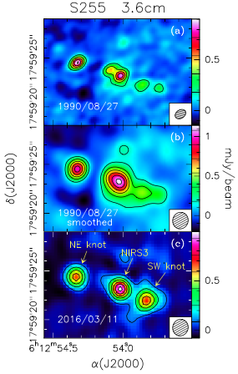
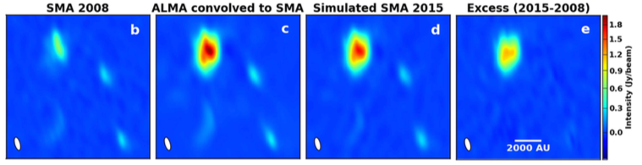
HMSF
Masers
M2O
G358
Future work
Episodic accretion:
Known accretion bursts
S255NIRS3
NGC6334I
Notes:
Accretion burst causes burst of IR

Slide 5
HMSF
Masers
M2O
G358
Future work
Episodic accretion:
Known accretion bursts
Notes:
Accretion burst causes burst of IR
Difficult to monitor continuum obs (ALMA, SMA)

Slide 6
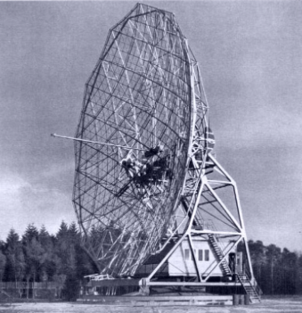
HMSF
Masers
M2O
G358
Future work
Maser emission:
responsive to changes in local environment
More
seed photons
Enhance excitation conditions
Inverted population
CMB
or
Increase path length
Notes:
How masers relate to SF activity

Slide 7
HMSF
Masers
M2O
G358
Future work
Typical environments
H₂O
CH₃OH
6.7 GHz methanol maser
traces radiation near the protostar
Burns et al. 2017, MNRAS, 467, 2367
Notes:
New shock / change in physicals -> maser emission change

Slide 8
HMSF
Masers
M2O
G358
Future work
Typical environments
H₂O
CH₃OH
6.7 GHz methanol maser
traces radiation near the protostar
Burns et al. 2017, MNRAS, 467, 2367
Notes:
New shock / change in physicals -> maser emission change

Slide 9
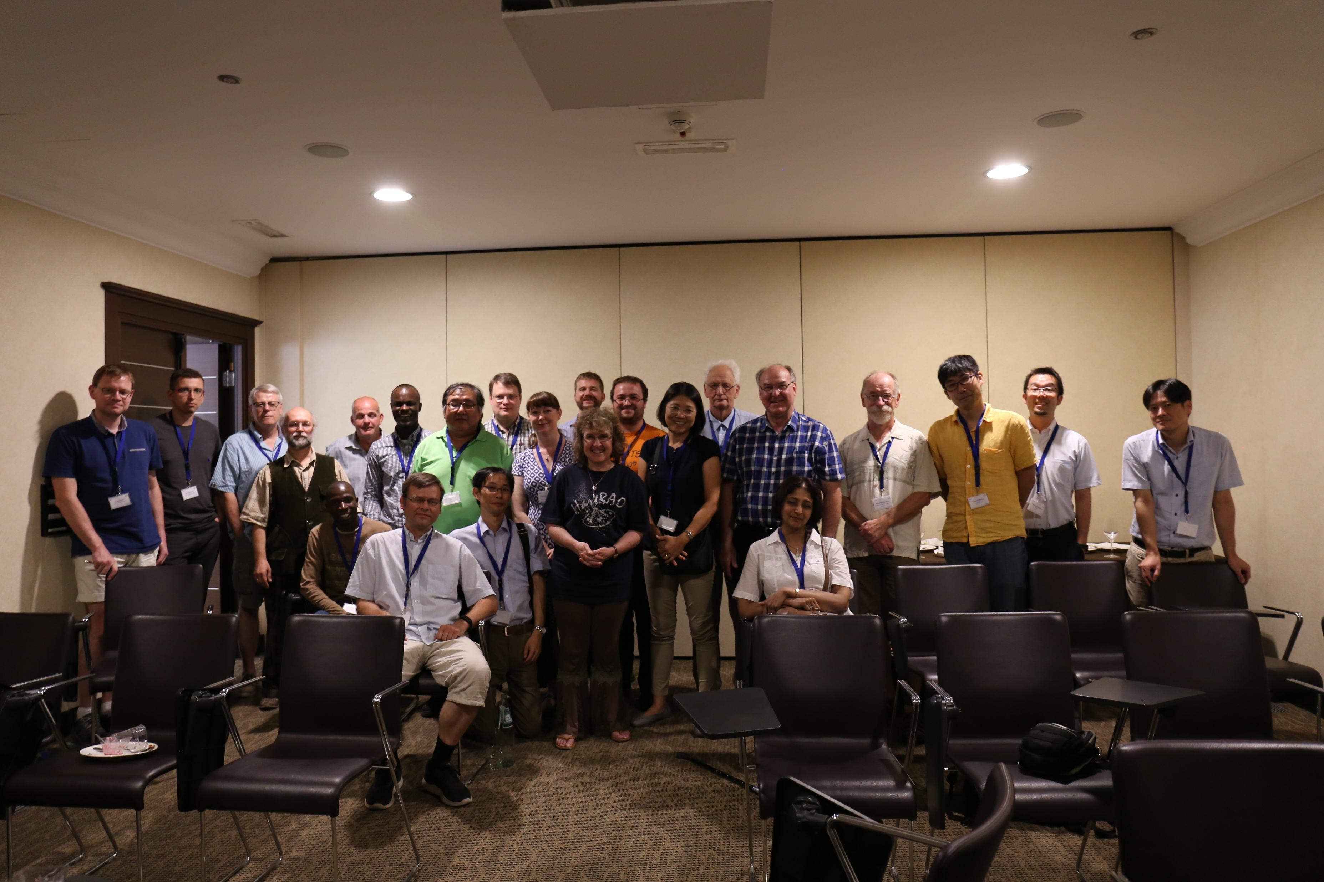
[M2O] Maser Monitoring Organization
HMSF
Masers
M2O
G358
Future work
Launch: 2017/09/07 @IAU Symp. 336
Aim: Unique flux monitor & Follow-up at Radio/NIR
Participants: Australia, Canada, China, France, Italy, Japan, Korea, Latvia, Poland, Russia, South Africa, Thailand, Ukraine, USA
© Dr. G. MacLeod

Slide 10
[M2O] Maser Monitoring Organization
HMSF
Masers
M2O
G358
Future work
Launch: 2017/09/07 @IAU Symp. 336
Aim: Unique flux monitor & Follow-up at Radio/NIR
Participants: Australia, Canada, China, France, Italy, Japan, Korea, Latvia, Poland, Russia, South Africa, Thailand, Ukraine, USA
M2O contrubing Observatories
Hartebeesthoek
Torun
Ibaraki
VERA (Sunada)
Effelsberg
Medicina
Puschino
Ventspils
Today
62 members
5 maser bursts
32 Follow-ups
22 papers accepted/in prep.
© Dr. G. MacLeod

Slide 11
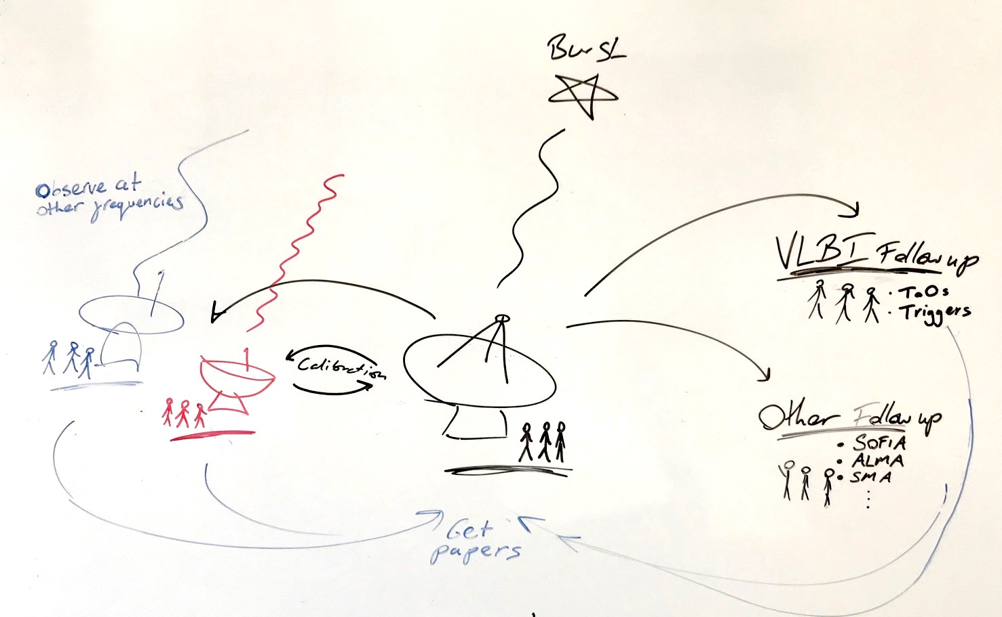
HMSF
Masers
M2O
G358
Future work

Slide 12
HMSF
Masers
M2O
G358
Future work

Slide 13
HMSF
Masers
M2O
G358
Future work

Slide 14
HMSF
Masers
M2O
G358
Future work
H₂O
CH₃OH

Slide 15
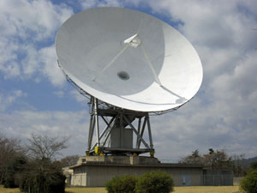
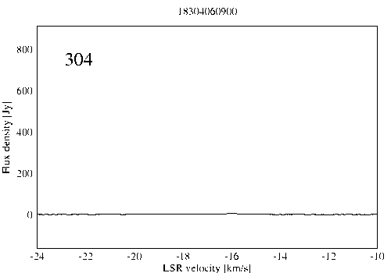
High-mass YSO:
G358.93-0.03
HMSF
Masers
M2O
G358
Future work
H₂O
CH₃OH
3 order of mag at max
Only in just a month!
Hitachi 32m
Operated by Ibaraki-U
Sugiyama-san alerted the M2O in mid January 2019
Daily monitoring
© Ibaraki Univ.
http://vlbi.sci.ibaraki.ac.jp/iMet/G358.9-00-190114/
KS, Y. Yonekura, et al. (2019), ATel

Slide 16
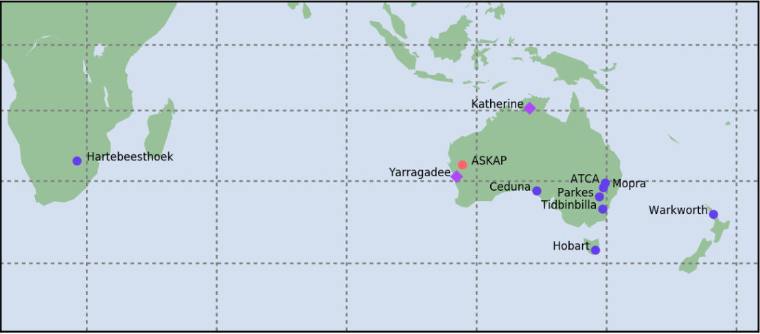
HMSF
Masers
M2O
G358
Future work
VLBI follow-up:
Long Baseline Array (LBA)
【Telescopes】
ATCA, Ceduna, Hobart, Mopra, Warkworth, Hartebeesthoek
ATCA, Ceduna, Hobart, Mopra, Warkworth, Parkes
【Obs】
2nd Feb 2019 (half month after burst)
28th Feb 2019
【Freq.】
6.668 GHz
【Vel. spacing】
0.045 km/s
【Note】 Phase referencing
6.7 GHz CH₃OH
Drastic rising

Slide 17
HMSF
Masers
M2O
G358
Future work
VLBI follow-up:
Long Baseline Array (LBA)
not public
Interpretation
Temp
150-200 K
Radius
Compact (260 au @ 6.75 kpc)
Ring-like
Center on MM1 (Brogan+ 19)

Slide 18
HMSF
Masers
M2O
G358
Future work
VLBI follow-up:
Long Baseline Array (LBA)
not public
Interpretation
Temp
150-200 K
Radius
Compact (260 au @ 6.75 kpc)
Ring-like
Center on MM1 (Brogan+ 19)

Slide 19

HMSF
Masers
M2O
G358
Future work
26 days
Results
not public
not public
Implies a translocation of 1-2 mas/day, which is 11,700 to 23,400 km/s at the source's kinematic distance of 6.75 kpc (equivalent to 0.04 to 0.08c).
Methanol masers die at v >10 km/s i.e. Too fast to be proper motion

Slide 20
HMSF
Masers
M2O
G358
Future work
Concluding
viewpoints:
The M2O: effective communication and follow-up
Discovered a “heat-wave” from the G358 accretion burst
Extreme maser evolution
Fast VLBI responses critical
Dissimilar to S255 / NGC6334
(accretion burst `zoo’ ?)
G358 6.7 GHz
Flux [Jy]

Slide 21
HMSF
Masers
M2O
G358
Future work

Slide 22
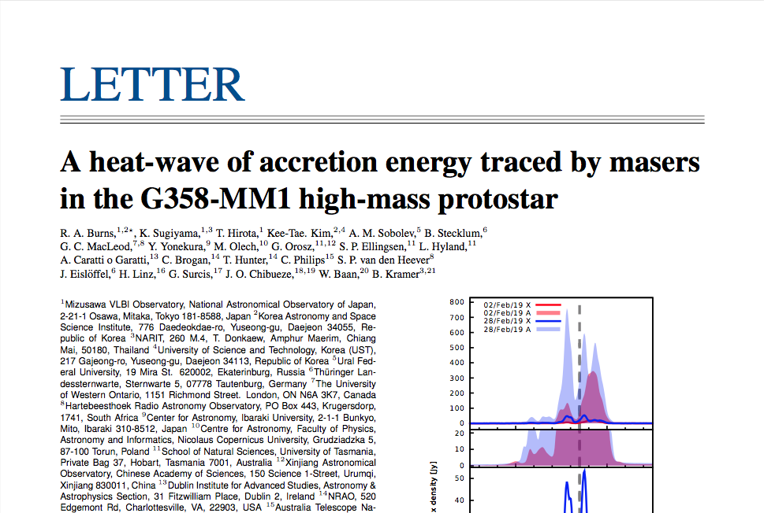
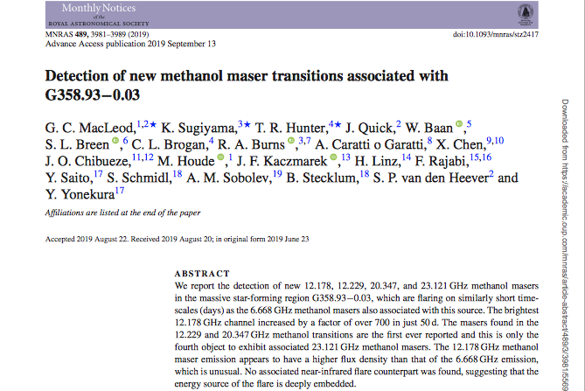
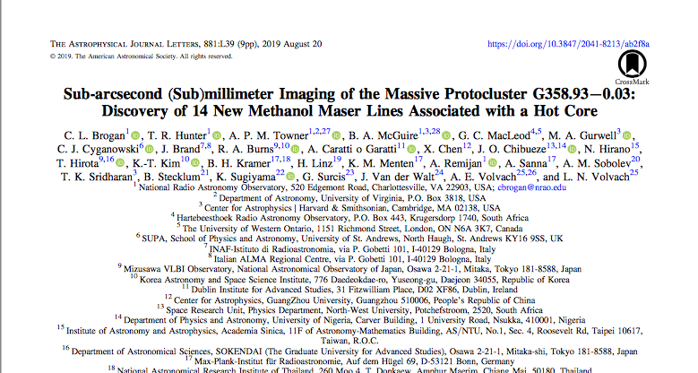
HMSF
Masers
M2O
G358
Future work

Slide 23
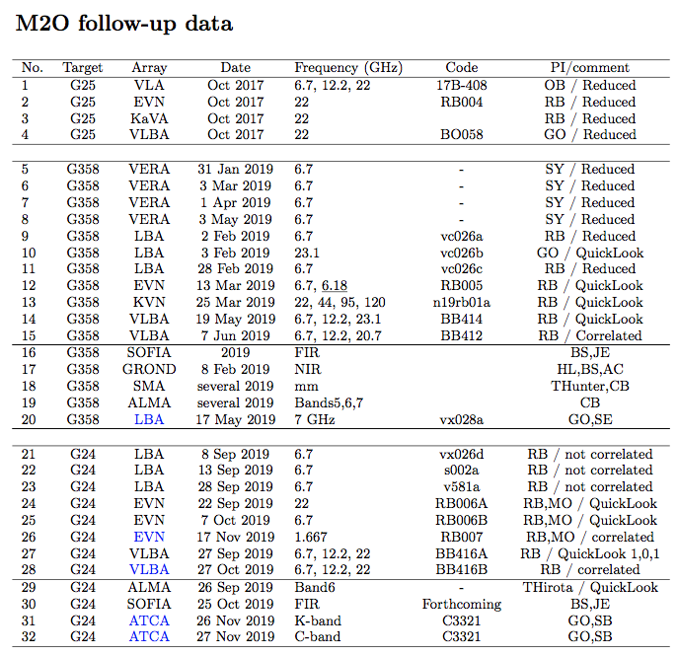
HMSF
Masers
M2O
G358
Future work
More data to consider:

Slide 24
HMSF
Masers
M2O
G358
Future work
Future work:
(M2O 2020)
Are all accretion bursts the same?
a possible `zoo’ of High Mass bursts?
What initiates accretion bursts?
deeper understanding of mechanisms
What else can be learned from these events?
refine the investigative process
Future direction of the M2O

Slide 25
Thank you

Slide 26
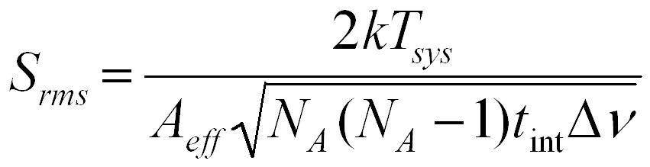
x 10
better sensitivity to weak reference sources
VERA - Inverse phase referencing
1 x Solint (3 min)
1 x Track (5 hr = 600 min)
Integration time = x 100
Sensitivity = x 10

Slide 27
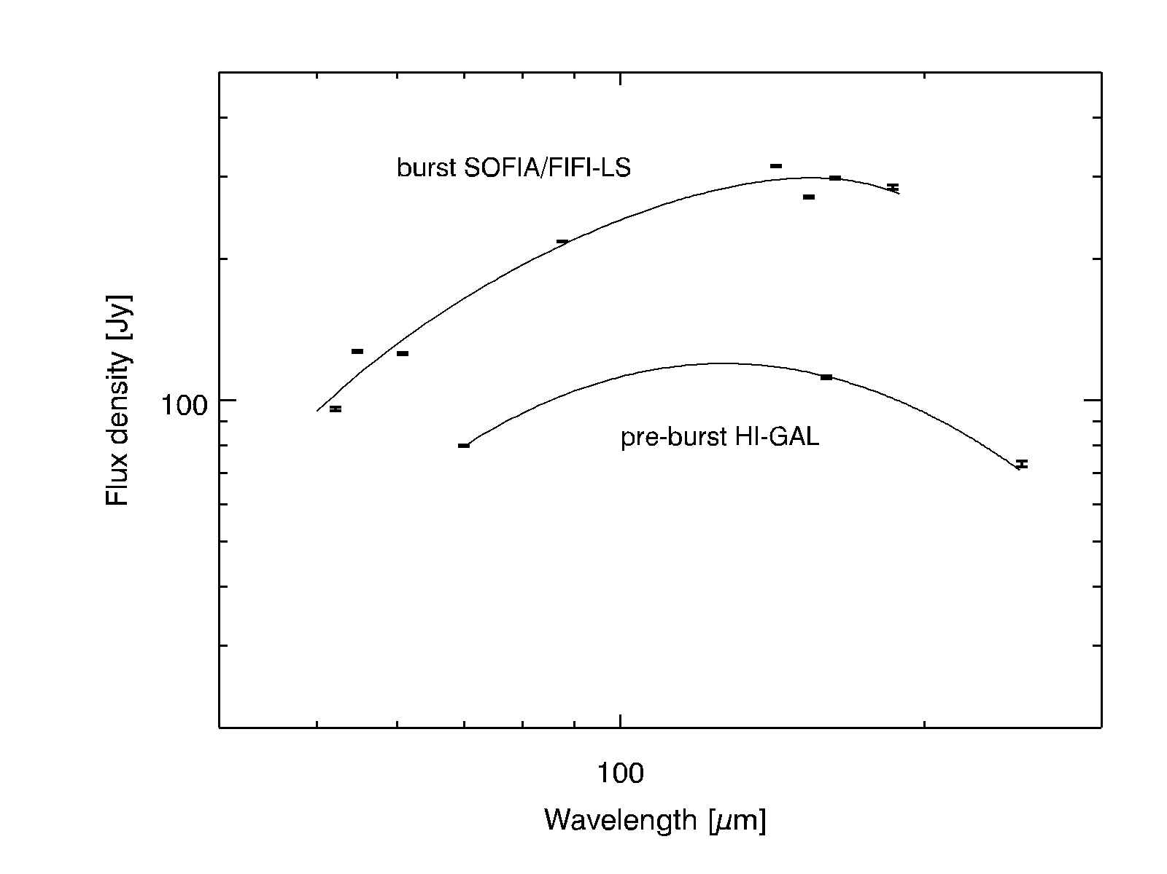
Masers
HMSF
M2O
G358
Future work
Spectral Energy Distribution

Slide 28
Masers
HMSF
M2O
G358
Future work
Episodic accretion:
Known accretion bursts
S255NIRS3
NGC6334I
Not densely
monitored
Notes:
Continuum burst -> maser burst
Retro: limiting follow up capabilities

Slide 29
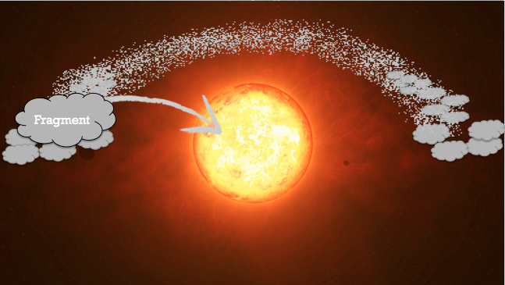
Theoretical solution:
“Episodic accretion”
Accretion from inner disk (via MRI)
Reference: Hosokawa et al., 2016, ApJ, 824, 119

Slide 30
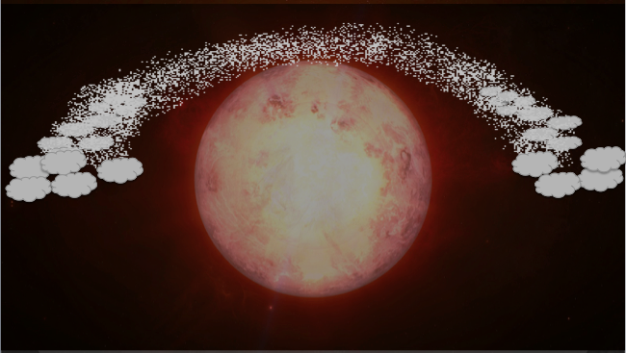
Theoretical solution:
“Episodic accretion”
Accretion from inner disk (via MRI)
Accretion burst
L = 4 π R² σ T⁴, star will ‘bloat’
Reference: Hosokawa et al., 2016, ApJ, 824, 119

Slide 31
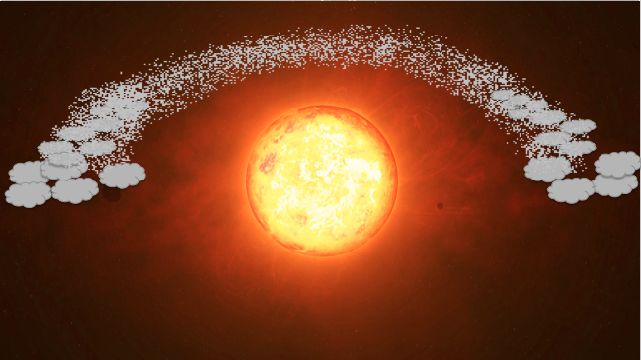
Theoretical solution:
“Episodic accretion”
Accretion from inner disk (via MRI)
Accretion burst
Beat radiation pressure
Build very massive stars
Gravitational contraction
L = 4 π R² σ T⁴, star will ‘bloat’
Reference: Hosokawa et al., 2016, ApJ, 824, 119
Notes:
Nice idea, but we lack evidence

